Slide 1
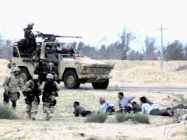
Process Detainees at
Point of Capture

Slide 2
Terminal Learning Objective
Action: Process detainees at the point of capture (POC).
Conditions: As a squad leader or platoon sergeant in a classroom environment, given FM 3-24, AR 190-8, and CALL Handbook 06-17. You have the theater rules of engagement. Employment of, non-organic assets such as unmanned aerial vehicles (UAVs) and sensors may be available. Contact with friendly, enemy, neutral or unknown elements is likely (CID).
Standard: Identify the steps necessary to plan, prepare, and execute processing detainees from the point of capture.

Slide 3
Administrative Data
Safety Requirements: None
Risk Assessment Level: Low
Environmental Considerations: None.
Evaluation: Student Checks; Practical Exercises
Notes:
SLIDE 03: Admin Data
No issues here.
During this class I will periodically ask questions concerning TQ to ensure you are absorbing the information.
This material may be on your written test.

Slide 4
Enabling Learning Objective
A
Action: Search a Detainee
Conditions: As a squad leader or platoon sergeant in a classroom environment, given FM 3-24, AR 190-8, and CALL Handbook 06-17.
Standard: Searched and restrained the detainee(s) sequentially IAW task performance steps, located and confiscated all weapons and/or contraband, and documented the search using a DD Form 2745 and DA Form 4137.

Slide 5
Detainee Operations
All Soldiers participating in military operations must be prepared to process detainees.
Detainees operations may pose significant operational risks that can impact mission success:
  Risk associated with disarming and disposing of ammunition and explosives
  Large numbers of captured personnel can overwhelm unit manpower and resources
  Emotional responses to captured personnel, who may have killed or injured fellow Soldiers, may provoke inappropriate behavior
  Proper handling of wounded or injured detainees may delay movement
Use the “5 S’s and T” technique until transfer of custody to the collection point: Search, Silence, Segregate, Safeguard, Speed to Safe Area & Tag

Slide 6
Point of Capture
The Point of Capture is the point on the ground where US forces capture combatants
  Usually associated with some level of combat engagement; can occur during any type of military operation
  Generally the most vulnerable at which Soldiers will capture detainees
  Requires Soldiers to disarm, restrain, search, and guard detainees in an unsecured environment
  Often associated with limited manpower, resources and medical support to provide for a large number of detainees
  Leaders and Soldiers may have to assess the risk between providing security against potential attacks and guarding detainees
The locations where the majority of detainee abuse allegations occur
  Emotions following enemy contact may run high
  Where the need for immediate intelligence may prevent additional casualties
  Must monitor unit/individual stress to reduce potential for further escalation and prevent violations of U.S. military policy

Slide 7
“5 S’s and T ”
Search: Actions taken to neutralize a detainee.
Silence: Prevent detainees from communicating with one another or from making audible clamor.
Segregate: Segregate detainees IAW local policy and SOPs.
Safeguard: Refers to your obligation to protect the safety of detainees and ensure the custody and integrity of confiscated items.
Speed: Quickly move detainees away from risks associated with the location of the point of capture.
Tag: Tag each detainee using a Capture Tag (DD Form 2745

Slide 8
Accountability of Detainee and Property
Accountability begins with the assignment of the Capture Tag (DD Form 2745)
Document confiscated items (weapons, personal property, items of intelligence/ evidentiary value) using an Evidence/Property Custody Document (DA Form 4137)
Annotate the Capture Tag Serial Number on all detainee-related documents
Proper documentation will provide:
  Information to make informed decisions on detainee status and whether to detain, release, transfer custody of, or prosecute
  An official record of the events surrounding the capture, which can be used to support or counter future claims such as loss of personal property
  If time or situation does not permit use of a DA Form 4137, then:
    Place items the large re-sealable bag
    Annotate the capture tag serial number on the bag using a permanent marker
    Transport confiscated items with the detainee
    Document confiscated items on the DA Form 4137 at the first opportunity

Slide 9
Field Processing Equipment
Soldiers should have access to a Detainee Field Processing Kit materials to facilitate appropriate processing:
A detainee field processing kit should include:
  1 12”x12” heavy duty re-sealable plastic bag (to hold items of kit)
  5 plastic zip ties (to secure detainees wrists, ankles if required and capture tags)
  4 latex/surgical gloves
  2 DD Forms 2745 (Capture Tag)
  1 marking pen (to write information on the tag)
  1 set of foam ear plugs
  2 clean cloths (for use as blindfold or muffle)
  1 GTA Card 19-07-001 – Enemy Prisoner of War Basic Commands. A language phrase card to facilitate actions at the point of capture.

Slide 10
Position Search Team
Supervisor positions members of the Search team:
  The guard, and interpreter will orient their positions based on the searcher:
    The guard and interpreter move to the opposite side of the side being searched
    The guard will maintain a clear line of sight with the detainee
    The interpreter will be positioned to best support the searcher, but is usually positioned to the rear flank of the guard
Search One Side
Then the Other Side
Guard
Interpreter
Searcher
Detainee (facing 12 O’clock)
The searcher provides lead during the search:
  Removes personal equipment (weapon, LBV, etc.) and keeps them out of the detainee’s reach
  Instructs the guard and interpreter as necessary
  Prepares and documents all confiscated items

Slide 11
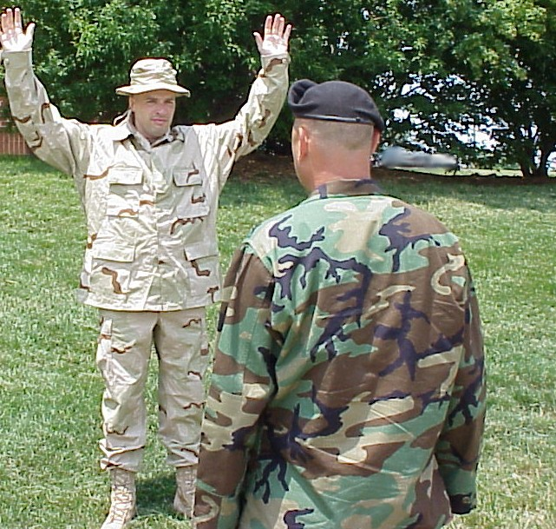
Position Detainee
Position the Detainee to be searched
The Searcher will:
  Use an interpreter to facilitate instructions
  Direct the detainee to stand and face you
  Direct the detainee to raise his arms above the head, lock elbows, spread fingers, with palms facing you
  Direct the detainee to pull up his shirt and shake it loose, have him turn around and repeat the same steps
  Instruct the detainee to remove his headgear, shake it out and drop it to the ground
  Continue to visually inspect for hidden weapons, IEDs, or contraband throughout this process

Slide 12
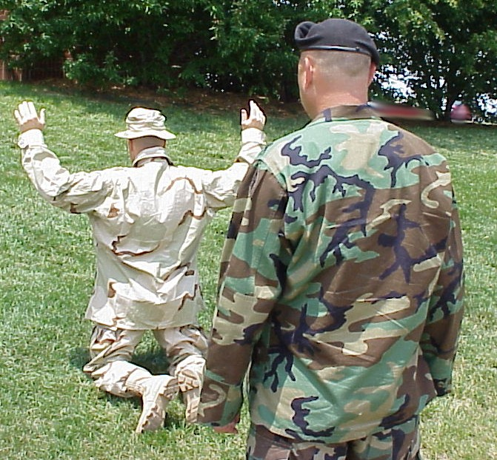
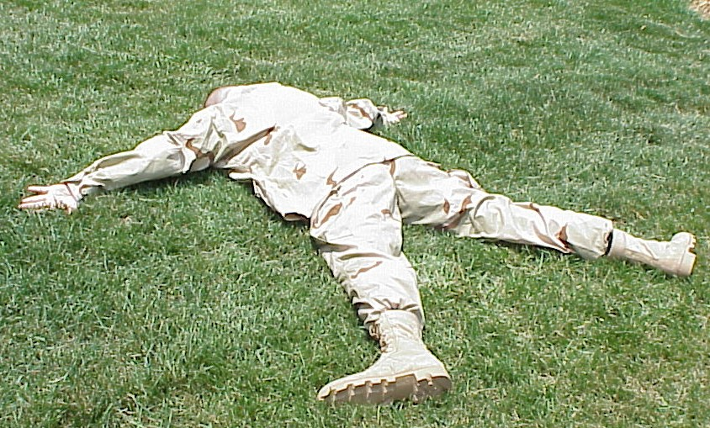
Position Detainee (cont)
Direct the detainee to drop to his knees
Search the back of the detainee’s hands and arms for hidden weapons or contraband
Direct the detainee to lie on the stomach and:
  Extend arms outward from his sides
  Rotate hands with palms facing up
  Place his forehead on the ground
Tell the detainee to spread his legs and:
  Turn his feet outward
  Place and keep his heels on the ground

Slide 13
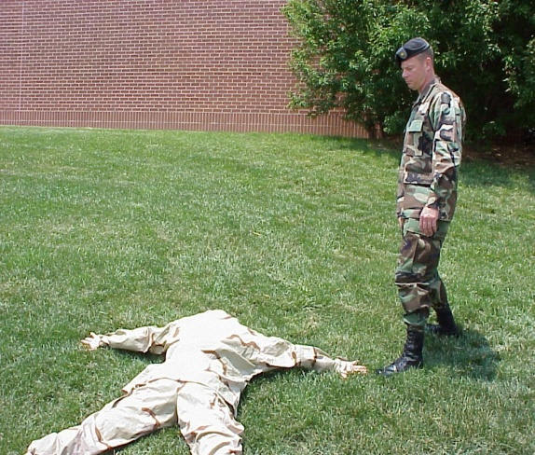
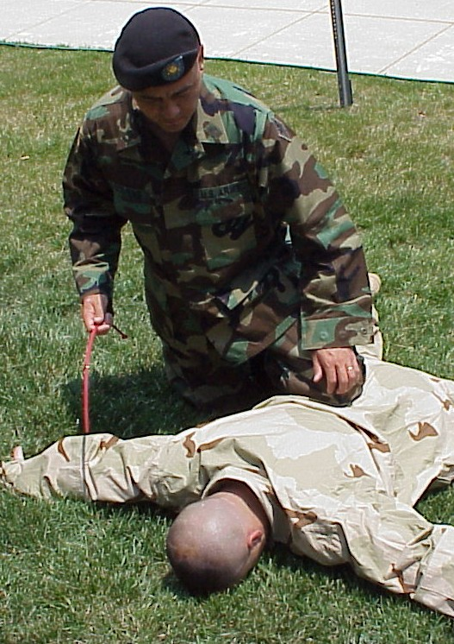
Restrain a Detainee
Guard will stay in front at a 45 degree angle to the detainee, opposite the side being searched
The searcher prepares to place flexi cuffs on the detainee (may place blindfold or muffle as appropriate)
Searcher approaches the detainee from the front at about a 45-degree angle, opposite side of the guard
The search will focus on one side of the detainee at a time
Squat, and then put the knee that is nearest the detainee, on the detainee’s lower back (this is done to ensure control, not to inflict pain or discomfort)

Slide 14
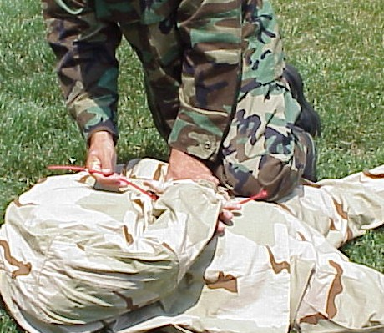
Restrain a Detainee (cont)
Direct the detainee to put his arm that is nearest the searcher behind him, on his back, with the palm facing up
Grasp the detainee’s other hand in a handshake hold and pull it across the other hand
Place the flexi cuffs on and pull to tighten
You are now ready to search
Continue to periodically inspect restraints

Slide 15
Search a Detainee
Search Overview:
  Searches are used to quickly detect contraband or weapons that may cause injury or death
  When possible, conduct same-gender searches
  Use the crushing technique to search a detainee:
    Grab loose clothing and squeeze to detect objects hidden under or within clothing or garments
    Cover each area by repeating the crushing technique until you are sure that there are no hidden objects
  If a weapon is found the Searcher will loudly announce it (e.g., gun, knife, etc.):
    Guard is alerted and postured for action
    Searcher will maintain contact to control the detainee
    Searcher will remove weapon, stand-up, and move away from the detainee to place it in a safe location within view of the guard
    Return and continue searching

Slide 16
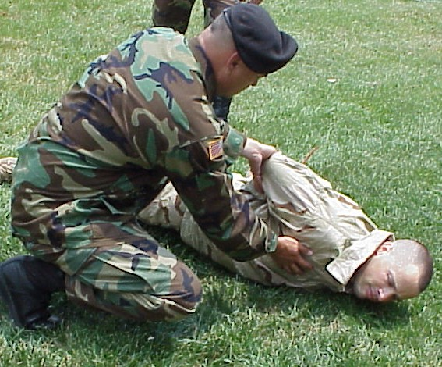
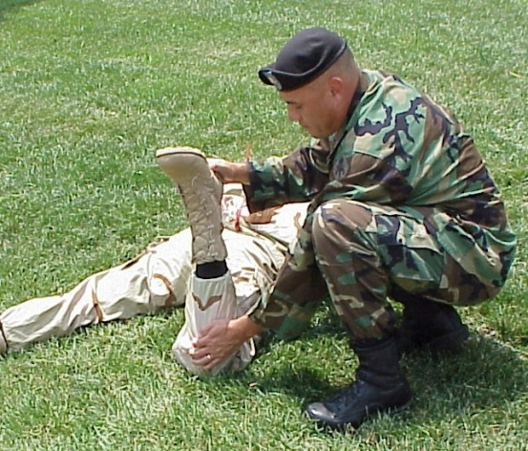
Search a Detainee (cont)
Hold the flexi cuff between the hands and lift the detainee’s arms slightly. Search the area on the small of the back
Release the flexi cuff and stand
Move to the detainee’s waist and face his head. Squat, but do not rest on the ground or near the detainee. Pivot, if required, to conduct the rest of the search
Remove the detainee’s headgear (if not already removed)
Search head and hair
Search from fingers to shoulders
Search detainee’s back from shoulder to waist on the Searcher’s side
Grasp the inside of the detainee’s closest elbow and pull him upward onto his side just high enough to search the front shoulder to waist. Check the bra area on females

Slide 17
Search a Detainee (cont)
Switch hands while controlling detainee’s elbow without changing position.
Search the detainee from waist to knee, including the crotch.
Return the detainee to face down position and release the elbow
Tell the detainee to raise their leg by bending the knee
Search from detainee’s knee to the foot. Insert finger in top edge of footwear and soles
Move to opposite side of the detainee without crossing between the guard and detainee
The Guard will rotate to the other side maintaining a 45 degree angle from the detainee’s head
The Searcher repeats steps to search the opposite side, searching from shoulder to foot

Slide 18
Complete the Search
Assist the detainee to stand up by:
  Turning the detainee onto his side facing away from searcher
  Direct the detainee to bring his knees to his chest
  Grasp the shoulder area and assist the detainee to his knees, then feet
The Guard remains focused on the detainee, observing the detainee’s demeanor
Document everything: in addition to capture tag entries, observe race, ethnicity, perceived status among captured, why the detainee was captured (e.g., violation of a curfew, possessed IED-making materials)
Circumstances of the capture are essential to:
  Determine detainee status
  Make informed decisions to release, retain, or transfer custody
  Collect and document all confiscated items of intelligence
  Collect and document all confiscated items of evidentiary value in preparation for future judicial proceedings

Slide 19
Document the Capture and the Search
Before you transport, tag the detainee and document confiscated items (weapons, personal items, items of intelligence/evidentiary value):
  Complete Capture Tag (DD Form 2745), preferably immediately after the search to retain accuracy
  There are three categories of confiscated items:
    Returned to detainee (personal protective items, helmet, and personal clothing, exigent medical such as inhalers)
    Retained (weapons, pocket litter, electronics, high-value items)
    Destroyed items (weapons, ammunition, hazardous items, etc.)
  Mark all confiscated items with the Capture Tag Serial Number
  Do not touch/remove an IED—use your ROE, evacuate the area,
  and notify EOD

Slide 20
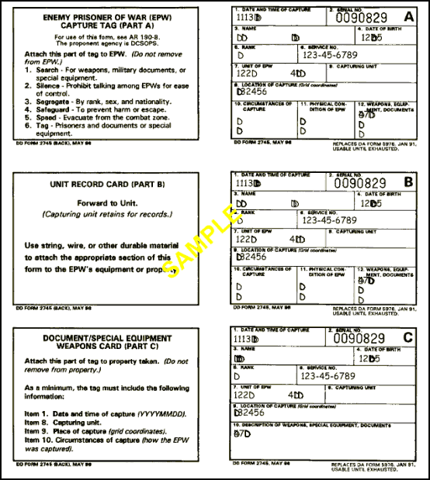
Capture Tag (DD Form 2745)
The searcher fills out the capture tag, noting:
  Date and time of capture
  Name (if available)
  Location of capture (reference known points)
  Capturing unit
  Circumstances of capture
  Possession of a weapon
  Detainee’s physical condition
Tag detainee & confiscated bundle; use all 3 copies:
  Attach part A to the detainee
  Retain part B for official records
  Attach part C to confiscated items
Initial segregation may be based on information documented on the tag
Notes:
Move back to search
Spell out detainee bundle.
Spell out Capture tag number is the only number authorized for tracking until an ISN is assigned.
No substitute for Capture Tag

Slide 21
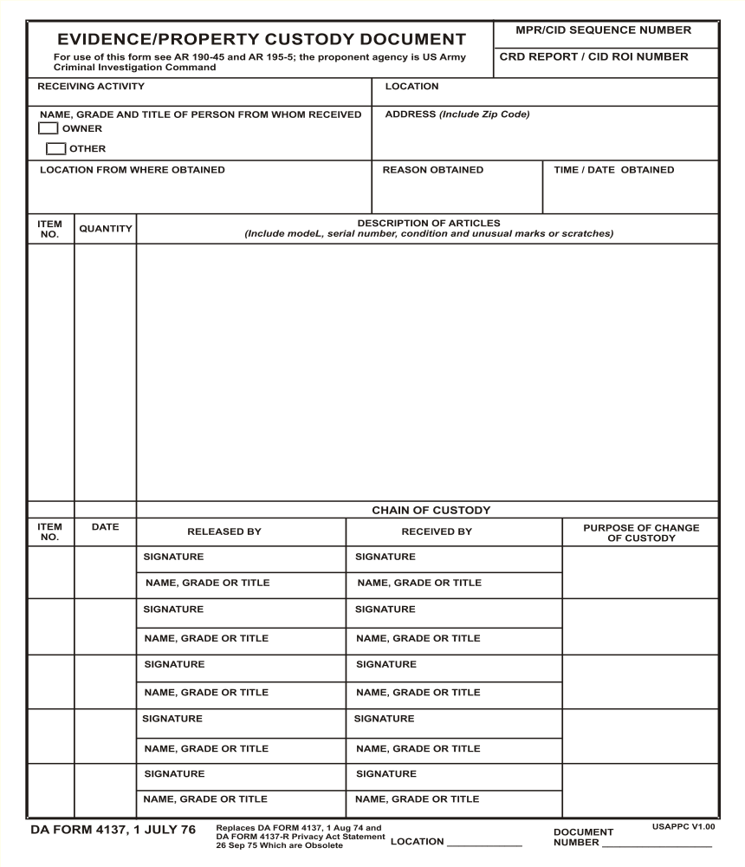
Evidence/Property Custody Document (DA Form 4137)
Fill out the DA Form 4137 at the earliest opportunity
Document all confiscated items; may be used as evidence for future judicial proceedings
Used to transfer, inventory, and maintain chain of custody
Form accompanies detainee and
property from point-of-capture to internment facility
Clearly & methodically annotate each item confiscated
Annotate Capture Tag Serial Number on the document
Detainee should sign form to acknowledge information
Signed by gaining custodian during every detainee & property custody transfer

Slide 22
Evidence/Property Custody Document (DA Form 4137)
Demonstration
Step 1: Header Information
Step 2: Description of Articles
Step 3: Chain of Custody

Slide 23
Evidence/Property Custody Document (DA Form 4137)
0008924
Capture Tag Number
Step 1: Header
B Co., 8th Engineer Battalion
Al Kisilk, Iraq
X
Mumar Mufassi
49 Pharaoh Street, Al Kisilk, Iraq
From the hand of Detainee
Retained as Evidence
1425, 7 Jul 05
Example

Slide 24
Evidence/Property Custody Document (DA Form 4137)
0008924
Step 1:
B Co., 8th Engineer Battalion
Al Kisilk, Iraq
X
Mumar Mufassi
49 Pharaoh Street, Al Kisilk, Iraq
From the Detainee
Retained as Evidence
1425, 7 Jul 05
1 1 .45 Caliber pistol, Serial Number 19181711, with one .45 magazine and two
.45 rounds.
2 1 Brown paper bag.
3 20 $5 bills in US Currency.
4 10 $10 bills in US Currency.
5 5 $20 bills in US Currency.
6 1 ID Card, bearing the name of “Mumar Mufassi”.
Example
Step 2: Description
Briefly itemize property to be taken.

Slide 25
Evidence/Property Custody Document (DA Form 4137)
0008924
Step 1:
B Co., 8th Engineer Battalion
Al Kisik, Iraq
X
Mumar Mufassi
49 Pharaoh Street, Al Kisilk, Iraq
From the hand of Mumar Muffasi
Retained as Evidence
1425, 7 Jul 05
1 1 .45 Caliber pistol, Serial Number 19181711, with one .45 cal magazine and two
.45 cal rounds.
2 1 Brown paper bag.
3 20 $5 bills in US Currency.
4 10 $10 bills in US Currency.
5 5 $20 bills in US Currency.
6 1 ID Card, bearing the name of “Mumar Mufassi”.
Example
Step 2:
Signatures and
Purpose
7 Jul 05
Mumar Muffasi
Ivan Short
Collection of Evidence
1-6
Mumar Muffassi
PFC Ivan Short
1
7 Jul 05
Ivan Short
Ivan Short
Destroyed in field.
Annotations to document destruction of property in field (as needed/appropriate)
Step 3: Chain of Custody
PFC Ivan Short
PFC Ivan Short
Released to Property Custodian
2-6
7 Jul 05
Ivan Short
John Jackson
PFC Ivan Short
SSG John Jackson
Annotations to document submission of property to unit

Slide 26
Search Summary
Ensure that you have flexi-cuffs and materials required for a Detainee Field Processing Kit
Know and rehearse search-team roles and responsibilities:
  Searcher provides lead for the search; focused on the search
  Guard provides security; always maintains a clear line of sight with detainee
  Interpreter will be positioned to best support the Searcher
Immediately disarm and safely restrain the detainee to ensure positive control
Continue to visually inspect for IEDs/weapons; react to an IED IAW ROE
Search head to foot, side to side, using the “crushing” technique
Accountability is initiated by issuing the Capture Tag Serial Number
Document the capture and search using the Capture Tag (DD 2745) and Evidence/Property Custody Document (DA Form 4137)
Link all confiscated items to the detainee by annotating the Capture Tag Serial Number on the DA Form 4137 and the re-sealable bag
Always:
  Safeguard detainees
  Ensure humane treatment, stop (!), report, and document all violations
  Keep detainees and their confiscated property together

Slide 27
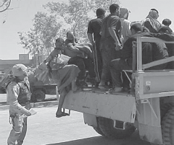
Enabling Learning Objective B
Action: Guard Detainees
Conditions: As a squad leader or platoon sergeant in a classroom environment, given FM 3-24, AR 190-8, and CALL Handbook 06-17.
Standard: Ensured detainees remain silent and segregated. Protect detainees from inhumane treatment, abuse, and harm. Reported inhumane treatment, abuse, and detainee noncompliance to your supervisor.

Slide 28
Guard Detainees

Slide 29
Operational Considerations
Detainee operations are dangerous; it is the only military operation that requires sustained, close contact with enemy/criminal persons
  Expect detainees to continue to plan and attempt to escape, disrupt detention operations, and harm or harass US captors
  Any relaxation of security will be immediately detected and fully exploited
Detainees should be firmly controlled, segregated, and instructed to remain silent
  Detainees should be either restrained or confined
  Guards must observe rigid self-discipline and maintain professional attitudes at all times
Guards are responsible for safeguarding detainees:
  Protect detainees from combat hazards, inhumane treatment, and inappropriate conditions
  Guards will ensure adequate food, water, clothing, and shelter
  Guards must afford detainees access to latrines and personal hygiene resources as available

Slide 30
Operational Considerations (cont)
Appropriate guard numbers and locations are based on:
  Number of detainees
  Segregation requirements
  Level of detainee threat/risk
  Type and design of confinement space available
Rotate guards to increase/sustain their vigilance
Soldiers should not guard detainees and provide operational security
at the same time
Guards must be trained and prepared to react decisively IAW
ROE/RUF
Ensure that guards are fully trained on the capabilities and limitations
of available non-lethal technologies
  Conduct a thorough risk assessment before integrating new technology into detainee operations
  Train and incorporate new technologies into unit SOPs before integrating them into security operations
  Understand release authority for use of non-lethal weapons
Always use an interpreter when available

Slide 31
Use of Restraints
Always use restraints when in contact, handling, or escorting detainees
Restraints should be periodically checked to ensure that they are secure without restricting circulation
Restraints should be removed when detainees are placed in a confinement space or other adequate confinement facility
  Restraints may be used in a cell to protect a detainee from self-harm
Restraints should normally allow detainees to stand, sit, and lie in a prone position
Unless seat-belted, avoid restraining detainees to fixed structure or objects while in transport
  Vehicle collisions could severely injure restrained limbs
  Ensure they are seat-belted on aircraft
Do not daisy-chain detainees (i.e., chaining two or more detainees together in a serial configuration)

Slide 32
Position, Observe and Report
Always maintain positive control and accountability of detainees
Ensure your weapons are functional, loaded, and prepared for use if needed.
Appropriate positioning:
  Guards must fully understand the limits of their post
  Guards should be close enough to maintain positive control but far enough away to allow defensive reaction time
  Guards faces toward the detainee(s), observe everything in their line of sight, and report all incidents to the supervisor
  When positioned with others, all guards must understand their mutually-supported sectors of fire, communications, and battle drills
  Observe and report detainee behavior
Guard will enforce silence and segregation as appropriate

Slide 33
Enforce Silence and Segregation
Ensure detainees remain silent:
  Do not speak to detainees unless providing orders/instructions
  If a detainee attempts unauthorized communication with other detainees:
    Attempt to stop behavior using language (interpreter) and/or hand signals
    If the individual continues, report to your supervisor and segregate or muffle as appropriate
      Use a soft, clean cloth stretched across the mouth and fastened around the back of the head
      Do not place items in the mouth, hood the detainee, nor use tape or other adhesives
Ensure detainees remain segregated
  If a detainee attempts to move out of the designated area or advances on a guard:
    Attempt to use language (interpreter) or hand signals to stop the behavior
    If the detainee continues, react in accordance with published ROE/RUF
    Notify your supervisor and document accordingly
Provide additional safeguards to protect segregated or silenced detainees

Slide 34
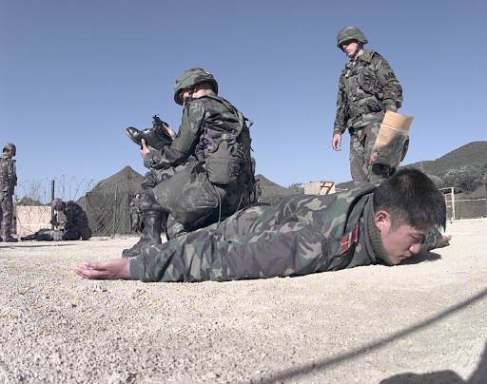
Safeguard
Correct, report, and document incidents of inhumane treatment, abuse, or inappropriate conditions
Document allegations of abuse and other incidents (e.g., in the Staff Duty Journal (DA Form 1594))
Protect detainees from combat hazards and conflict with each other
Protect women and children from any form of sexual abuse or harassment
No videotaping or photography except for administrative purposes
  e.g., documenting in personnel, intelligence, investigative, or medical files, etc

Slide 35
Rules of Engagement (ROE)/Rules of Use of Force (RUF)
The local ROE/RUF provides a legal template from which to engage
combatants
The ROE/RUF may be different or specifically tailored for detainee
operations
  ROE/RUF may change between pre and post-capture operations
You are personally accountable to understand and appropriately
employ ROE/RUF
You must be prepared to make split-second decisions IAW local
ROE/RUF
You may not respond appropriately, unless:
  You thoroughly understand the ROE/RUF
  You have trained on the ROE/RUF
  You have rehearsed the ROE/RUF for each specific mission
Guards must fully understand:
  Thresholds for the use of deadly force
  Thresholds for the use of non-lethal
  Requirements for warnings

Slide 36
Respond to Escape
React to an escape IAW rehearsed battle drills and SOPs
Adhere to local ROE/RUF
Maintain situational awareness:
  Allow Soldiers/guards closest to the escapee to recover the detainee
  Other/designated guards remain focused on remaining detainees
  Remaining detainees will attempt to exploit an escape, as they will any disruption
Always apply the minimum level of force to regain control of detainees
  Do not fire on detainees still contained within the wire
Segregate those who attempt escape to prevent reoccurrence and their ability to influence other detainees
Assess escapes thoroughly to prevent future occurrence
Escape Situation – Local ROE/RUF, normally:
  Step 1: Shout “Halt” three times in the local language
  Step 2: Use minimum force necessary to prevent escape. Use of weapon will be as a last resort (IAW ROE/RUF)
  Step 3: Use minimum force necessary to recapture the escapee

Slide 37
Generally Prohibited Acts
Retaliation of any kind
Use of physical or mental torture or any coercion to compel a detainee
to provide information:
  Use of military working dogs to intimidate or create fear; K9 will not be used during interrogation or tactical questioning
  Use of threatening gestures; or threatening a familial or associated persons
  Overly aggressive handling; avoid unnecessary physical contact
Videotaping or photography of detainees for public display or as
trophies, mementos, or personal memorabilia
  Photos are authorized for operational or administrative purposes only (i.e., post in official files such as investigative, intelligence, personnel, or medical files)
Conversing with detainees except to give orders or directives
Body cavity searches – unless authorized IAW DoD policy

Slide 38
Guard Summary
Any military operations may result in detainees; all Soldiers must be
prepared and trained to process detainees
Detainee operations are dangerous—only military operation requiring
sustained, close contact with the enemy
Use the 5 S’s & T technique to process at the point of capture
Point of capture is the 1st decision point to retain or release
Document and account for detainees and confiscated items
  If you don’t know why you are retaining a detainee at the point of
  capture, know one else will during subsequent custody transfers
You cannot respond appropriately to incidents, unless you understand,
trained, and rehearsed the ROE/RUF
You are responsible to safeguard detainees; correct, report, and
document violations

